Slide 1
Student Learning Management System (SLMS)
By: Group-4
Deepak Reddy
Deepu Gondhi
Shashank
Sadvik Kondadi
Nithin Reddy
Chandra Teja
Padmaja
Sanjay
Thanwish Ram

Slide 2
Multiple Views (1-4)
Admin Panel:
It lets administrators manage users, including students and instructors. It also creates and assigns courses, provides access to financial reports and customer support management, and enables course performance tracking.

Slide 3
Multiple Views (2-4)
Instructor Panel:
Instructors get access to create new courses and upload learning assets and both assignment setting and student grading and performance tracking capabilities.

Slide 4
Multiple Views (3-4)
Student Panel:
Student users browse courses before they enroll download resources and track their progress, then they submit assignments and make educational payments.

Slide 5
Multiple Views (4-4)
Customer Support Panel:
Staff can handle student questions through the panel while resolving cases independently but refer unanswered issues to administrators.

Slide 6



Tech Stack Model:
Front End
Database
Testing

Slide 7
Initial Planning (1-2)
Phase 1: Planning & System Design ()
• Define system requirements, features, and goals.
• Finalize the technology stack and tools.
Phase 2: Frontend Development ()
• Develop a login page with full functionality.
• Develop user interfaces for Admin, Instructor, Student, and Customer Support.
Phase 3: Database Operations ()
• Database Development Inserting the required data.
• Querying for required fetches for each application of Frontend.

Slide 8
Initial Planning (2-2)
Phase 4: Backend Development ()
• Integrating the Database.
• Final User Acceptance Testing and Debugging.
Phase 5: Testing and Deployment ()
• Unit Testing by each member of their developed component.
• Integration Testing using PyTest
• Deploy the Database and Streamlit app to Streamlit cloud.

Slide 9
Timeline Chart:
Gantt Chart
Phase | Start Date | End Date | Duration
Phase 1: Planning & System Design | Jan 20 2025 | Feb 3 2025 | 2 weeks
Phase 2: Frontend Development | Feb 4 2025 | Feb 24 2025 | 3 weeks
Phase 3: Database Operations | Feb 25 2025 | Mar 17 2025 | 3 weeks
Phase 4: Backend Development | Mar 18 2025 | Apr 7 2025 | 3 weeks
Phase 5: Testing and Deployment | Apr 8 2025 | Apr 21 2025 | 2 weeks
Phase 6 : Overall Project evaluation | A p r 22 2025 | Apr 28 2025 | 1 week

Slide 10
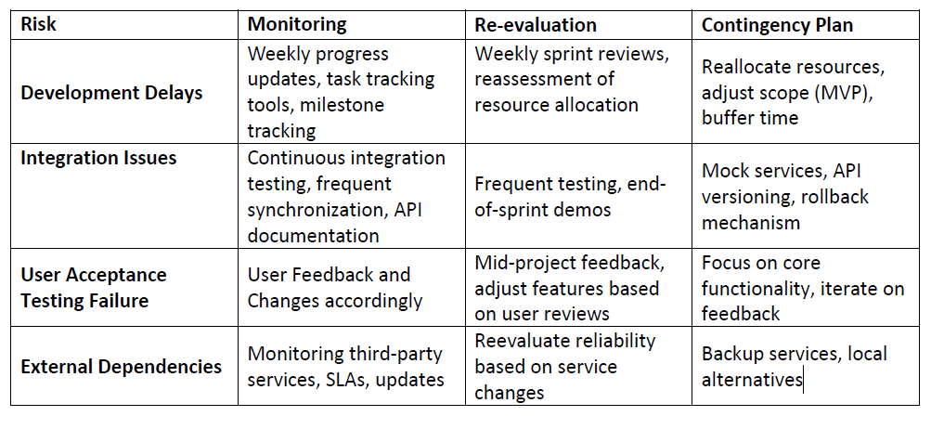
Risk Management:

Slide 11
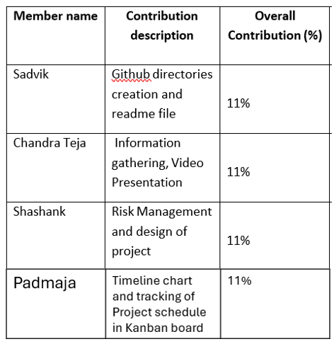
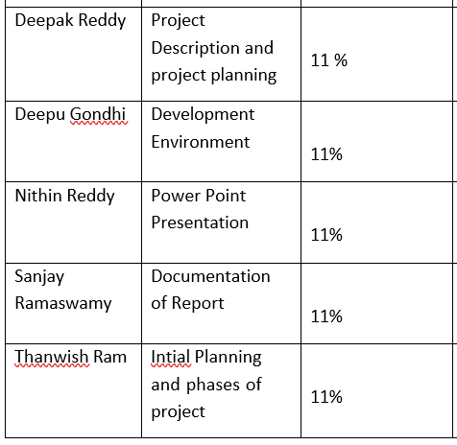
Roles in the Report:

